Slide 1
Operating System
Lab 1(A) Introduction to Linux

Slide 2
Todays Lab
Introduction to Linux
Linux Installation
Linux on V.M

Slide 3
Introduction
History of Linux
Other Operating Systems before Linux
  UNIX
  BSD
  Hurd
Linux(Linus) & GNU
  Open Source & Free

Slide 4
Linux is an OS Kernel
What is OS Kernel?
  Kernel is the government of computer
  Kernel abstracts the hardware
  Kernel controls the system resources
  A kernel by itself gets you nowhere
In addition to kernel, you need
  Shell, User Interface, Applications…
  Library and programming tools

Slide 5
Advantages
Stability
  It is very rarely to see the Kernel Panic
Free Software
  The is not any charge for software
Support Wide Range of Hardware
  Less memory
Security
  Open source → There is not any backdoor
  Quick bug fixing

Slide 6
Disadvantages
Leaning Curve
  Linux is NOT for dummies
Applications
  Some applications have NOT equivalent in Linux
  Some applications do NOT run in WINE
Official Support
  Companies need official support
  No one is responsible for most Linux applications

Slide 7
Virtual Machine
A virtual machine (VM) is a software implementation of a machine (i.e. a computer) that executes programs like a physical machine.
Also know as Hardware Machine

Slide 8
Advantages VM
Multiple OS environments can co-exist on the same computer
Virtual machine can provide an instruction set architecture (ISA) that is somewhat different from that of the real machine

Slide 9

Virtual Machine

Slide 10
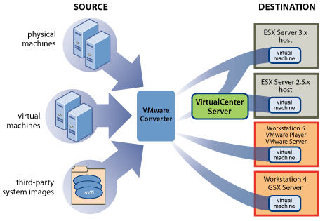
Virtual Machine

Slide 11
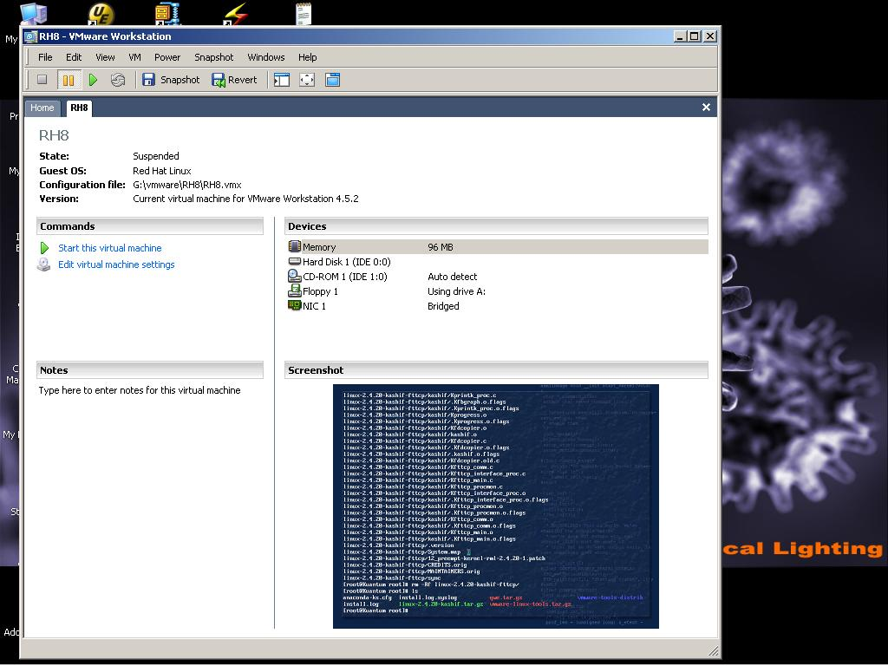
VMWare on Windows

Slide 12
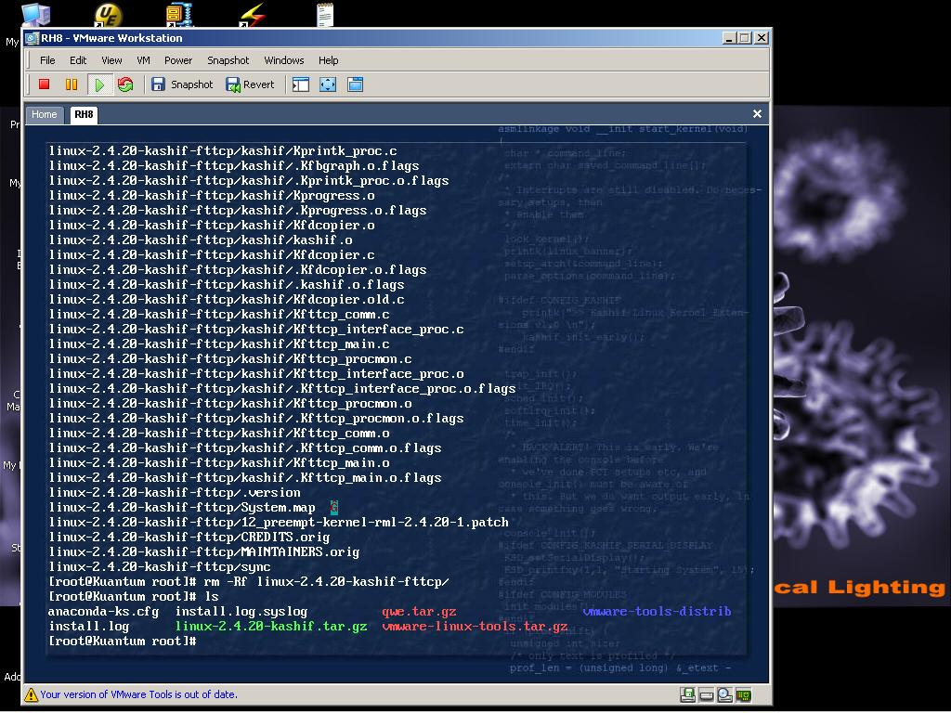
VMWare on Windows

Slide 13

Java Virtual Machine

Slide 14
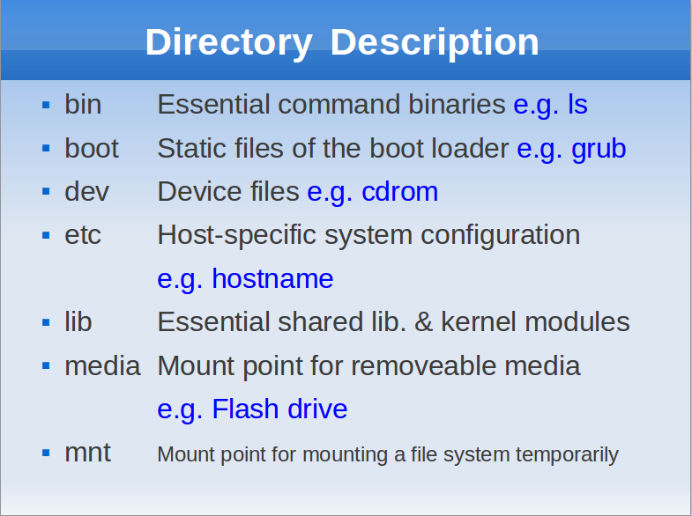


Slide 15
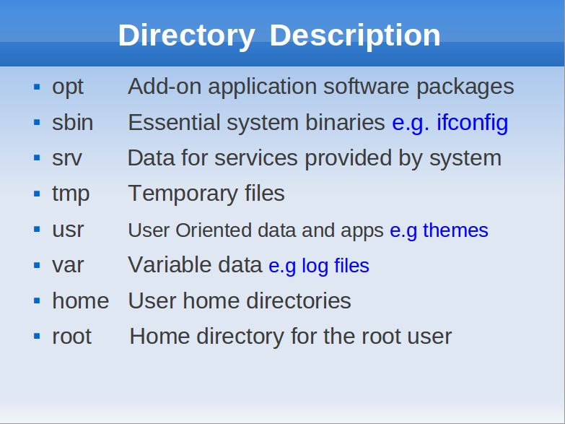

Slide 16
Lets get started with Installation

